Slide 1
Remote desktop access to Biolomics software A short guide
BioAware Support Team

Slide 2
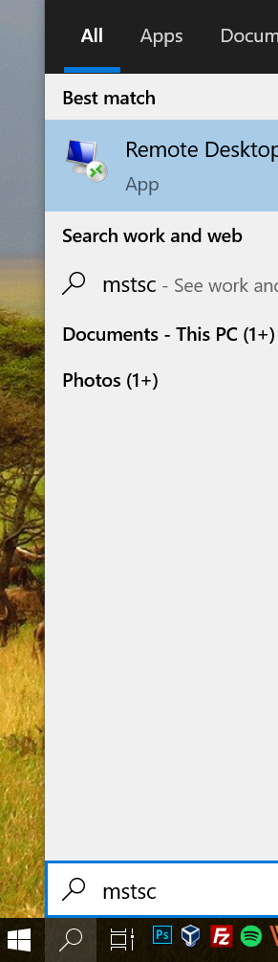
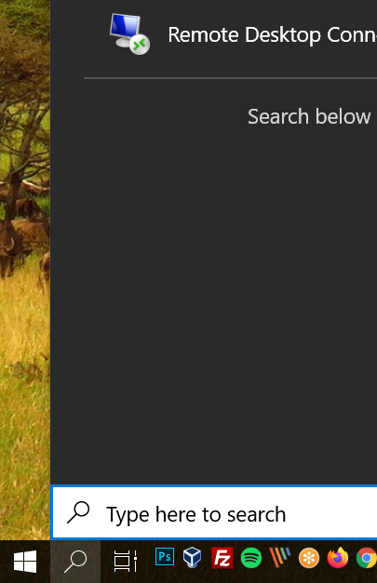
Step 1:
Click on the search tool of your
Windows PC that is located next to the Windows Start button (see screenshot).
See the “Type here to search” text.
Type “mstsc” (see screenshot; without the double quotes, of course).

Slide 3
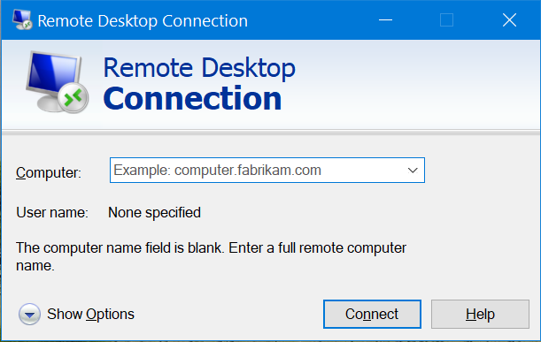
Step 2:
The following window will appear.
Click on the “Show Options” button.

Slide 4
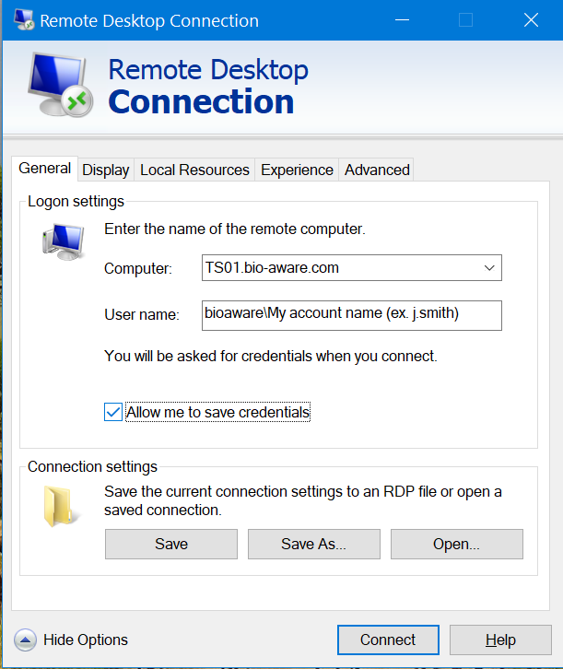
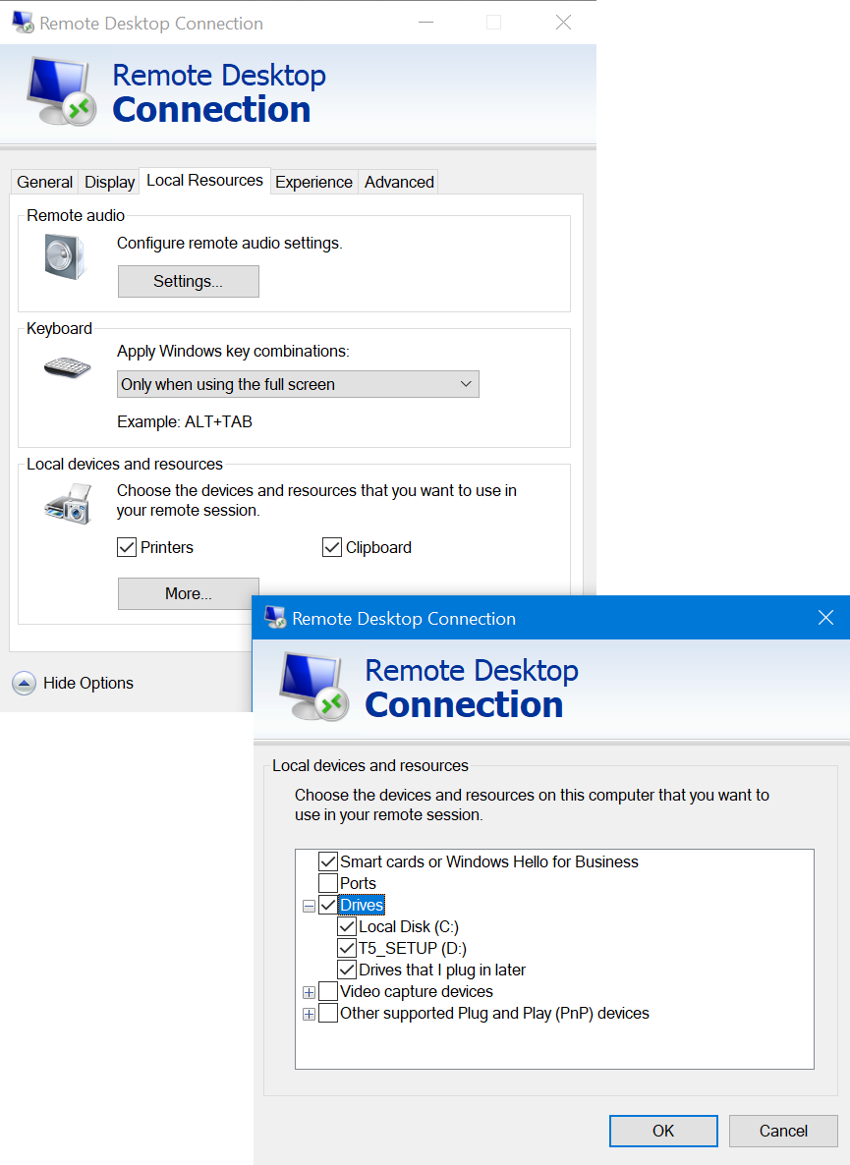
Step 3:
Enter the Computer address to connect to. In the example here “TS01.bio-aware.com” (note that you may have received another address. Please use the one given to you.
In the User name section, enter the domain name (Bioaware) + “\” + your login user name. The one you always use when stating BioloMICS with Citrix. Should look like: bioaware\j.smith
Check the “Allow me to save credentials” if you want to ease your access in the future. Also click on the Display or additional tabs if you want to change some additional options.
Also, if you want to see your local drives while working on the remore desktop, go to the “Local Resources” tab, click on the “More” button and select the drives that you want to see/use.

Slide 5
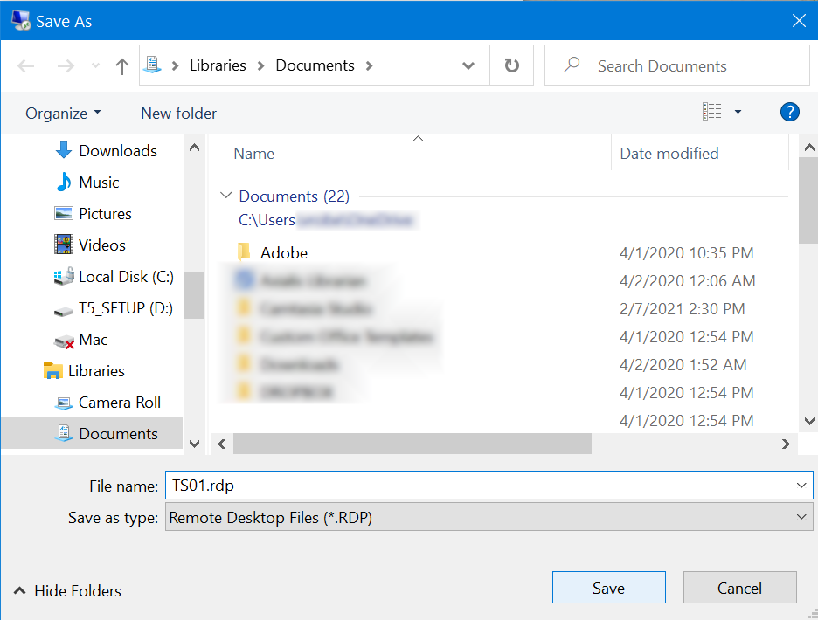
Step 4:
Click on the “Save as” button to a place to is easy for you to access to. Later, you will be able to double click on the saved connection (on its icon). To launch the access without re-doing all the previous steps.

Slide 6
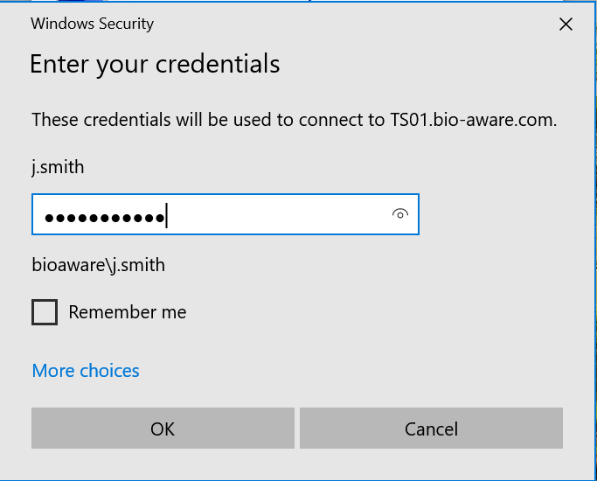
Step 5:
Enter the password associated with your account (the exact same one you were using in the past when login with Citrix).
Check the “Remember me” option if you want to skip this step in the future.
Click “OK”.

Slide 7
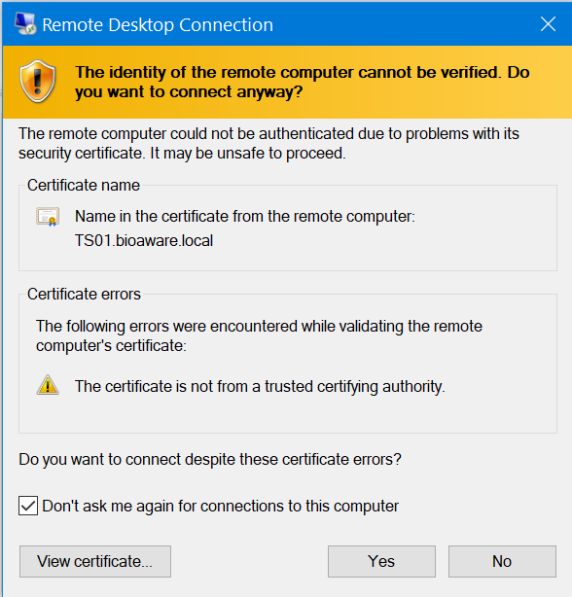
Step 6:
One or two windows will appear. Just click “Yes” or “OK”. You may check the “Don’t ask me again …” option.

Slide 8
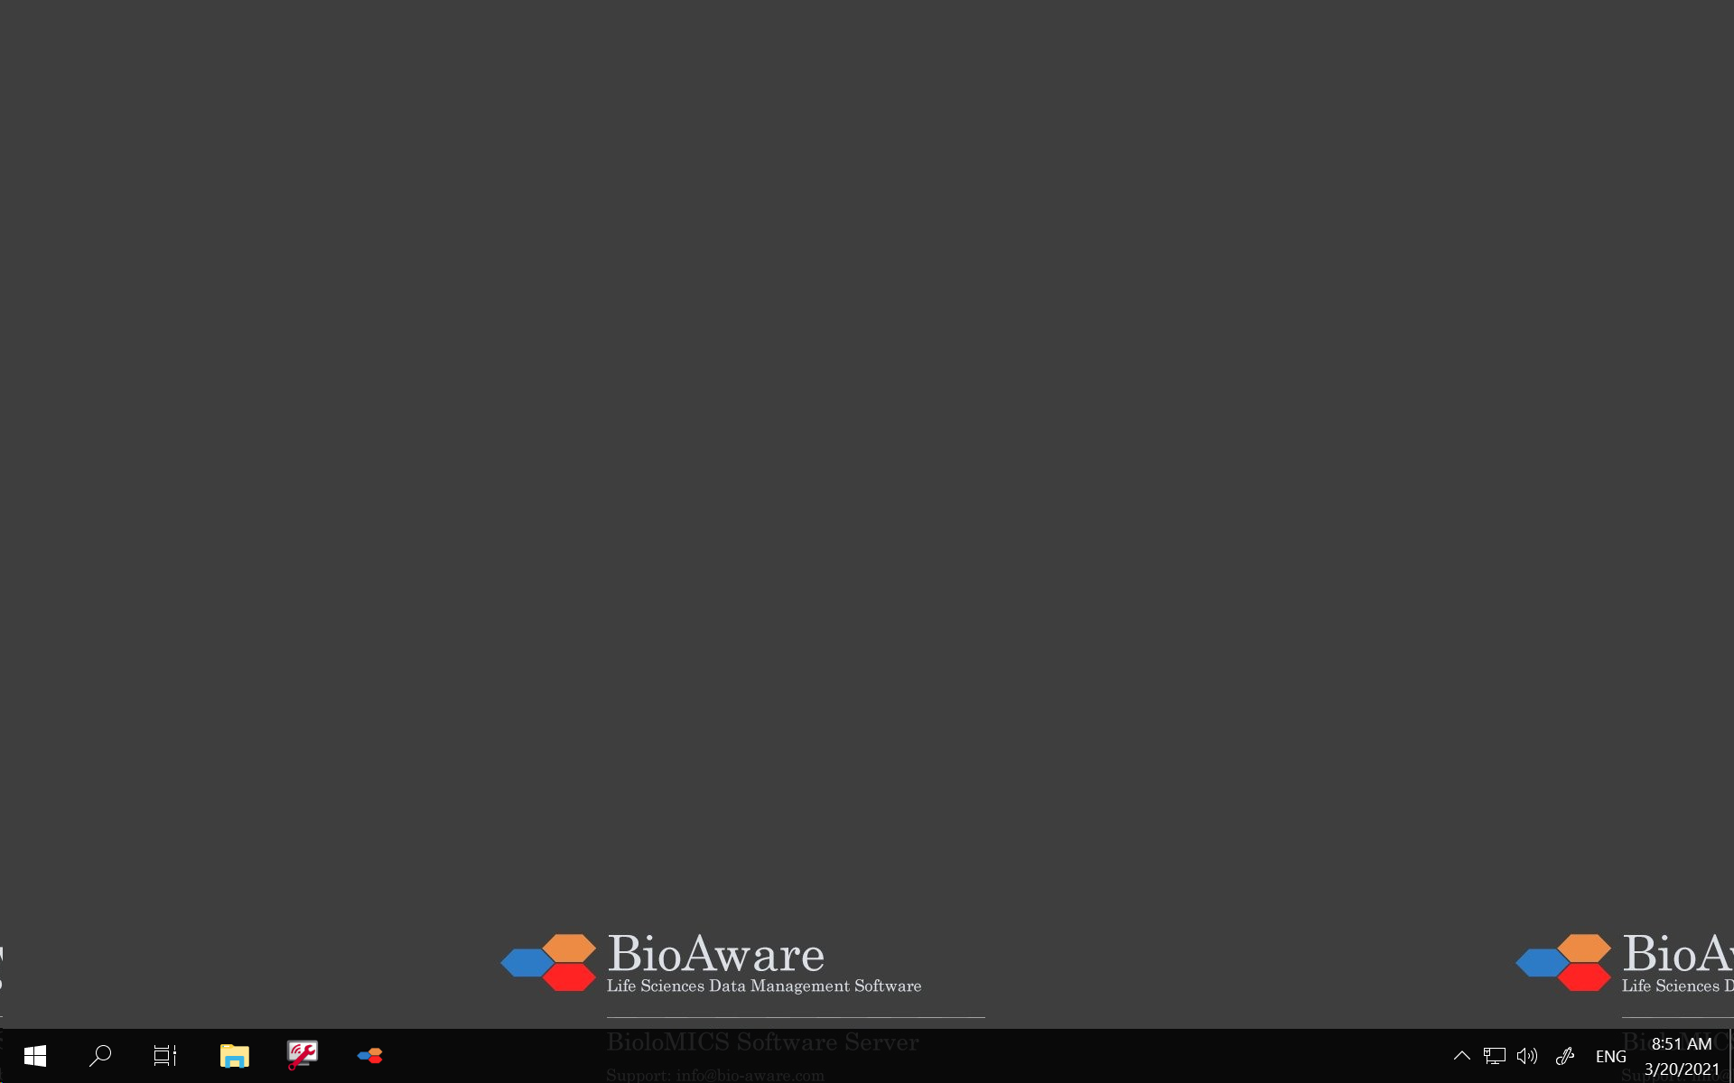

Step 7:
You are in. Congratulations. The screen should look similar to the one here but will have your preferences saved from your previous visit to the service.
If you are in a full screen mode, you will see a blue bar on top of the screen. Use the _ or options to come back to the screen of your local computer.
Remember that using RDP you are working on a distant computer. You can switch between local and distant computer. The latter will be looking like another opened software on the local machine.

Slide 9
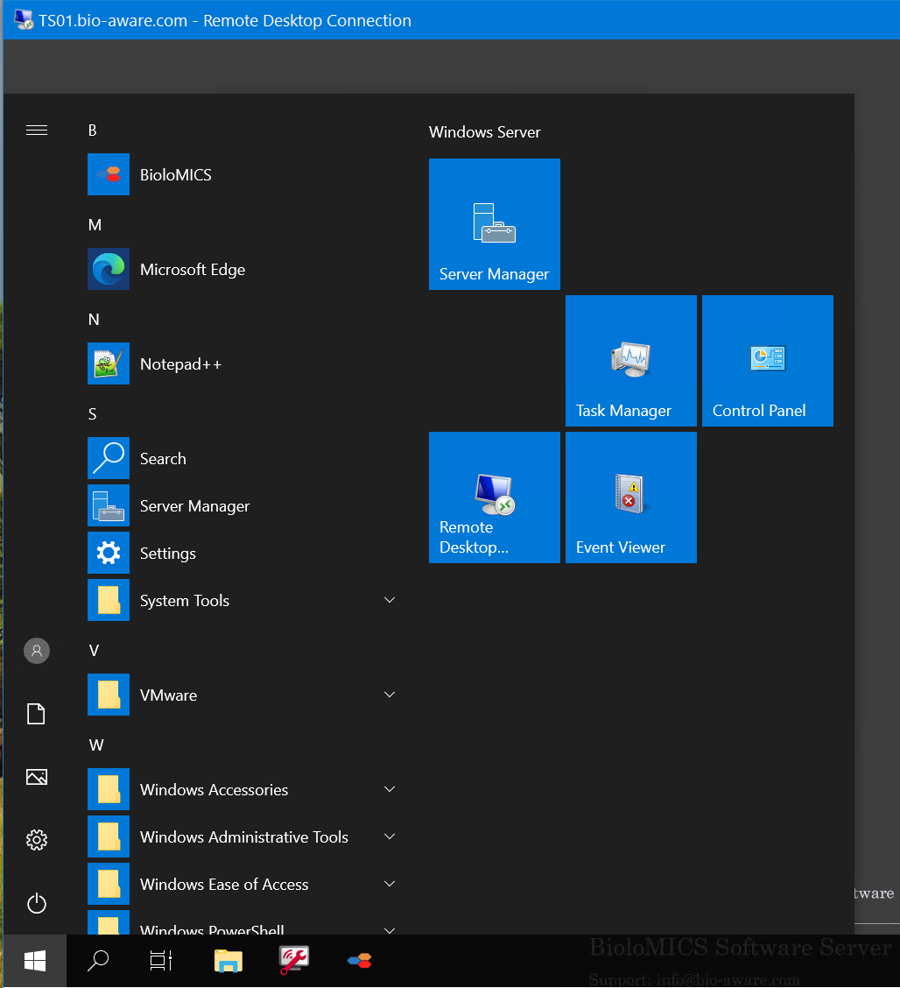
Step 8:
If you do not have the BioloMICS Icons present yet on your desktop, click on the Windows start menu and on top, see the BioloMICS icon. Click on it to start BioloMICS.

Slide 10
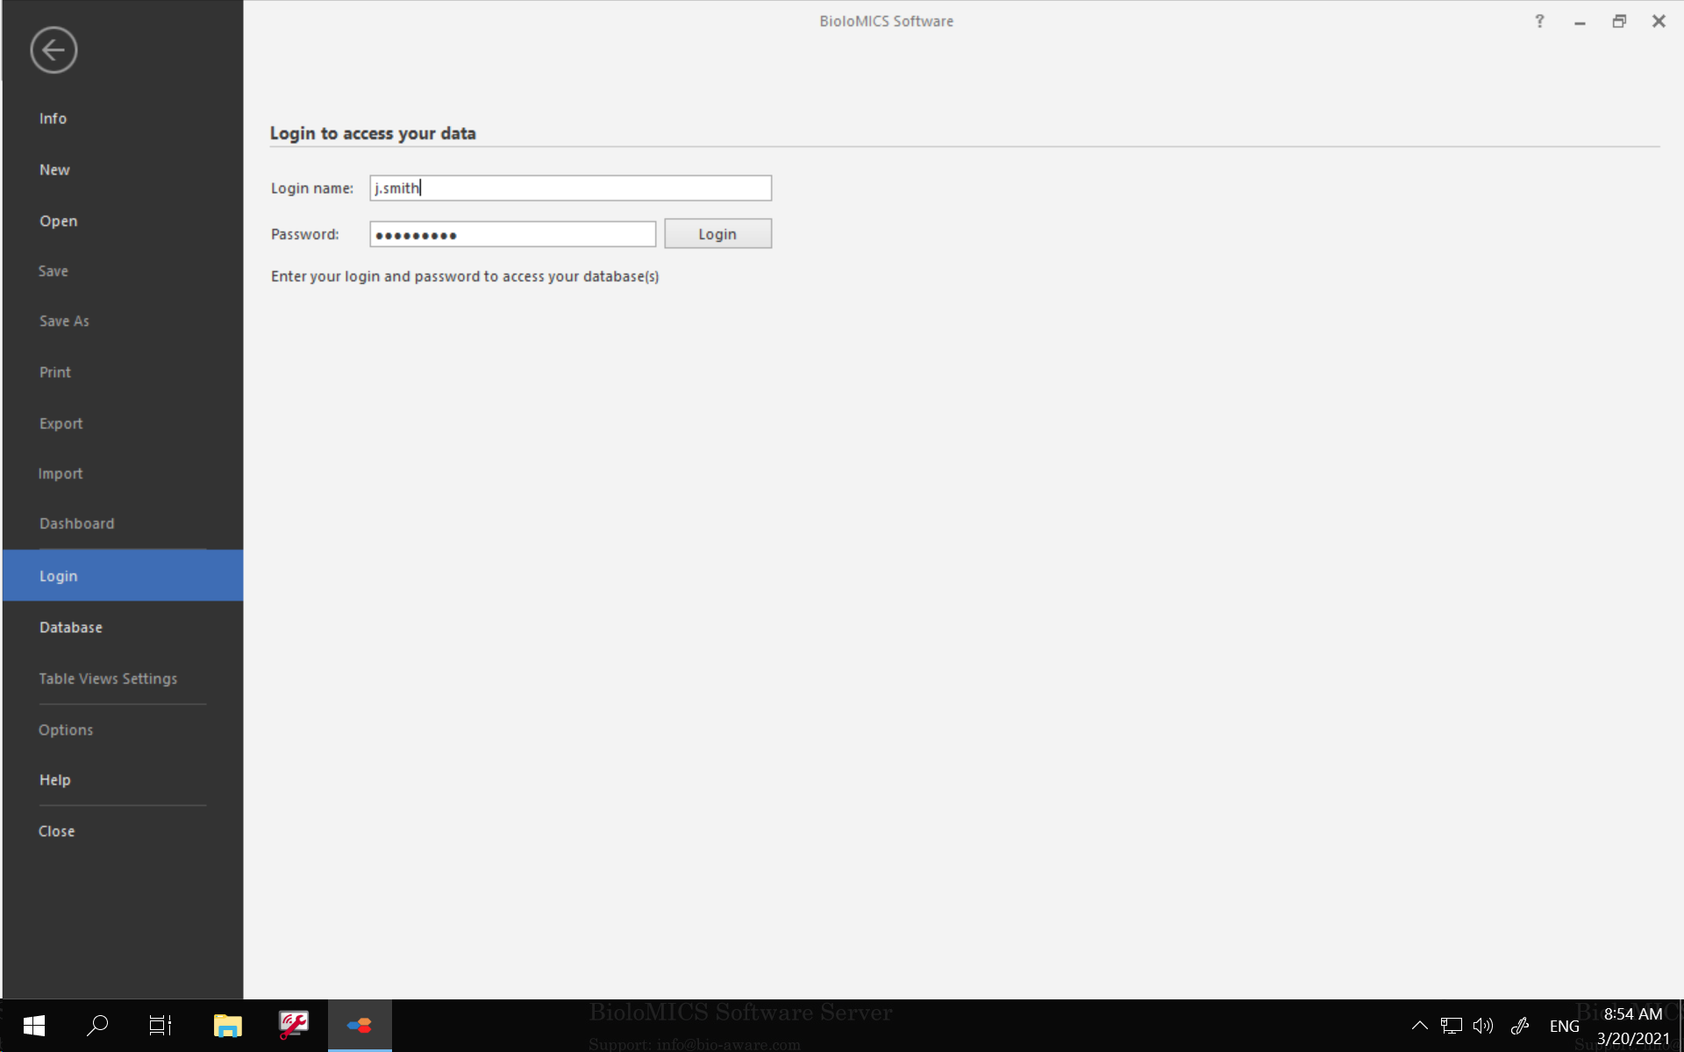
Step 9:
Enter your BioloMICS login + password as usual.

Slide 11
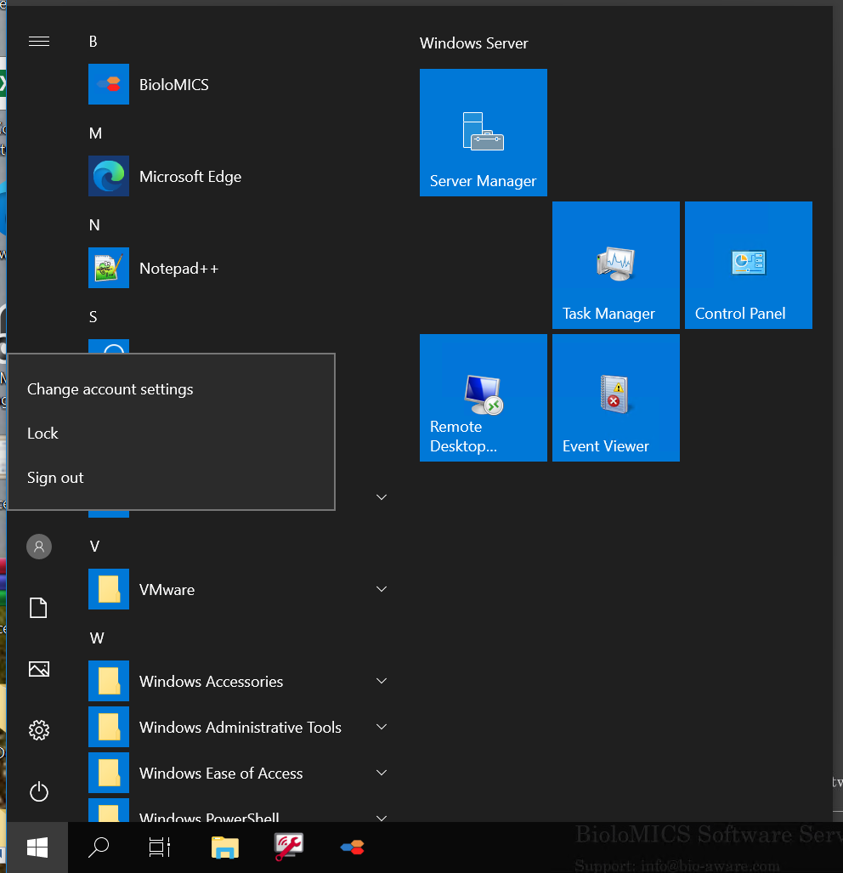
Step 10:
When you finish your work with BioloMICS close it properly using the X on the top right of the BioloMICS window.
Then, click on the Windows start button, then on the User icon, then click on the “Sign out” option.
Always close the session this way to free memory for other users.

Slide 12
Notes:
RDP connections require port 3389 to be opened on your machine. If the above steps are not working please do the following:
If you have the proper admin rights on your computer, open the 3389 port and follow the procedure described here (one of the many explaining it): How To Open RDP Port To Allow Remote Desktop Access To Your System (itechtics.com).
Contact your local IT as they may have implemented restrictive rules that may prevent you to use the RDP services.
Also, do not forget to logoff both BioloMICS and the remote desktop (see step 10) when you finish your work. This will free space for other users.

Slide 13
More information on Biolomics at www.bio-aware.com Contact info@bio-aware.com

